Slide 1
Thank a Farmer Friday–Waffles
February 25, 2022

Slide 2
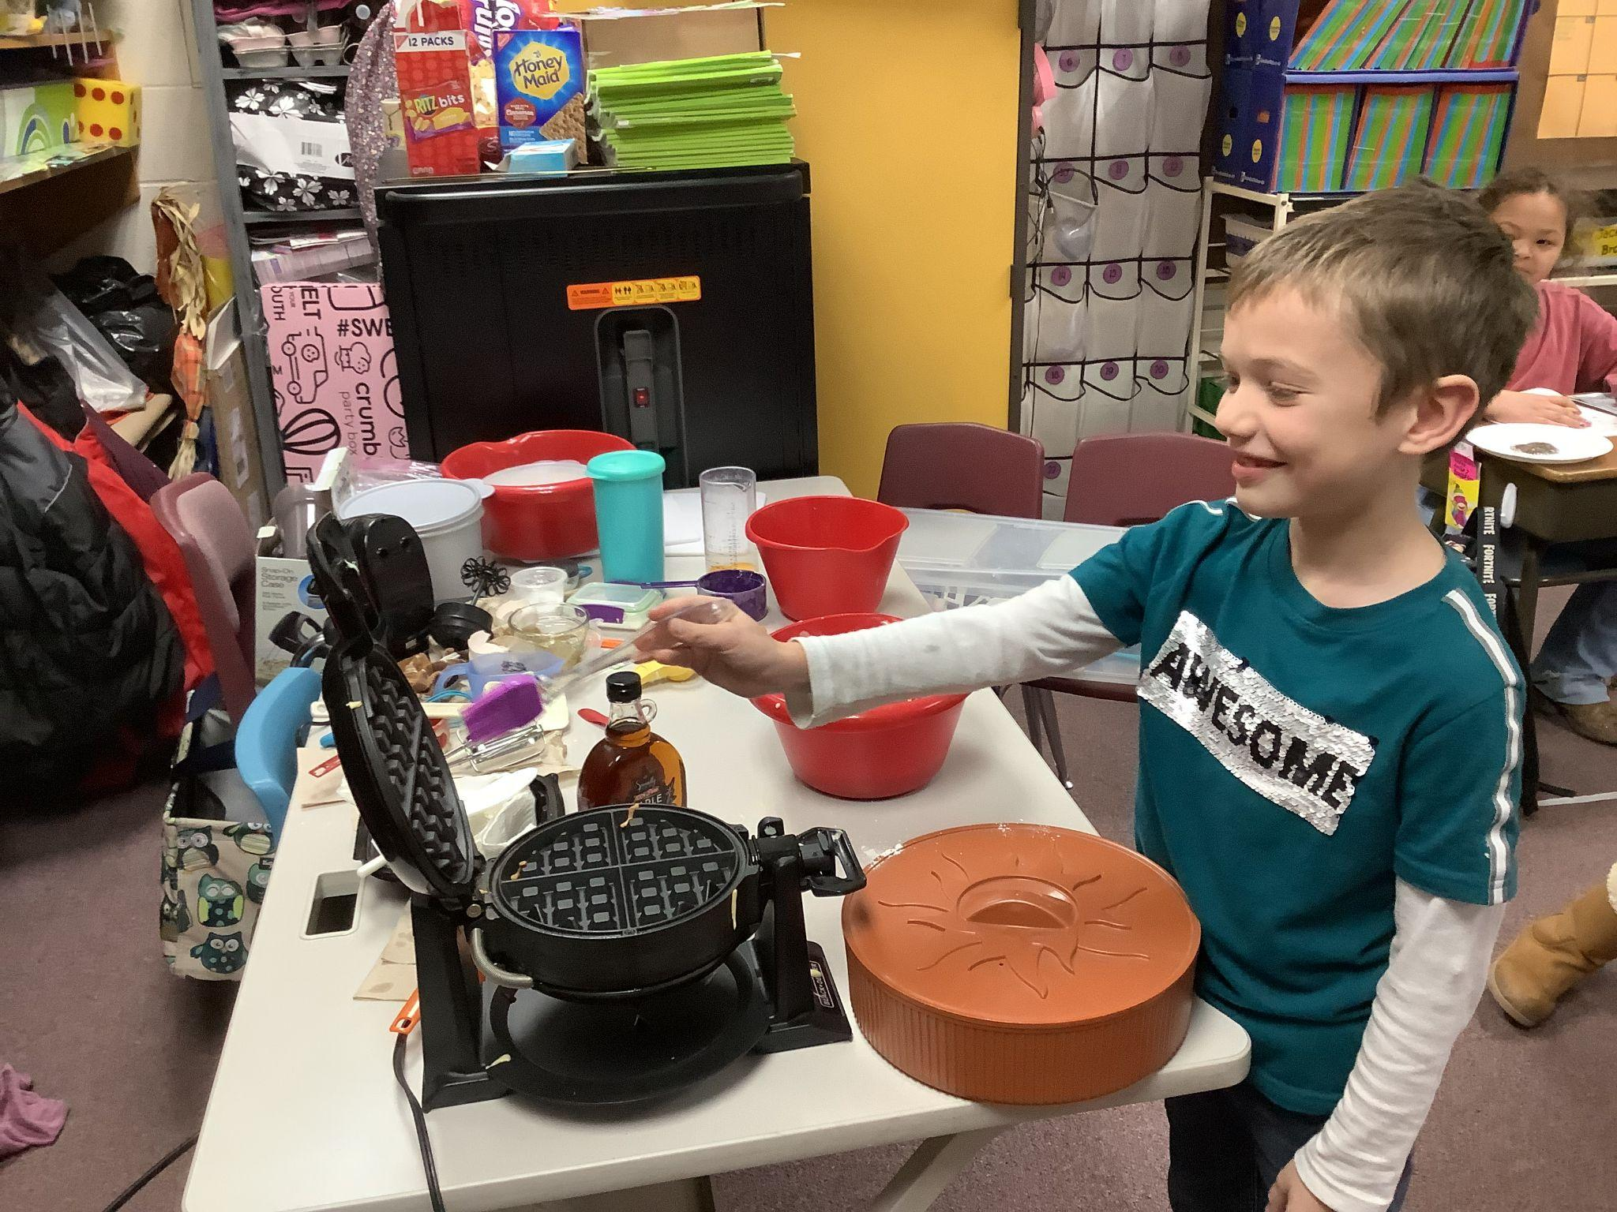
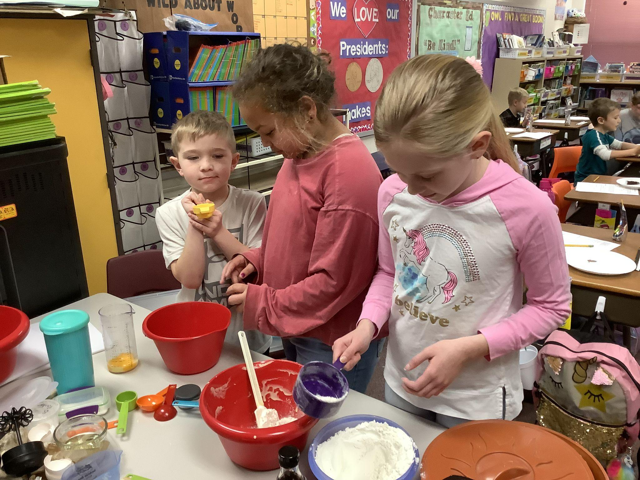
Mason oiled the griddle. Rosen poured in the flour, then Alisia and Elijah separated the eggs.

Slide 3
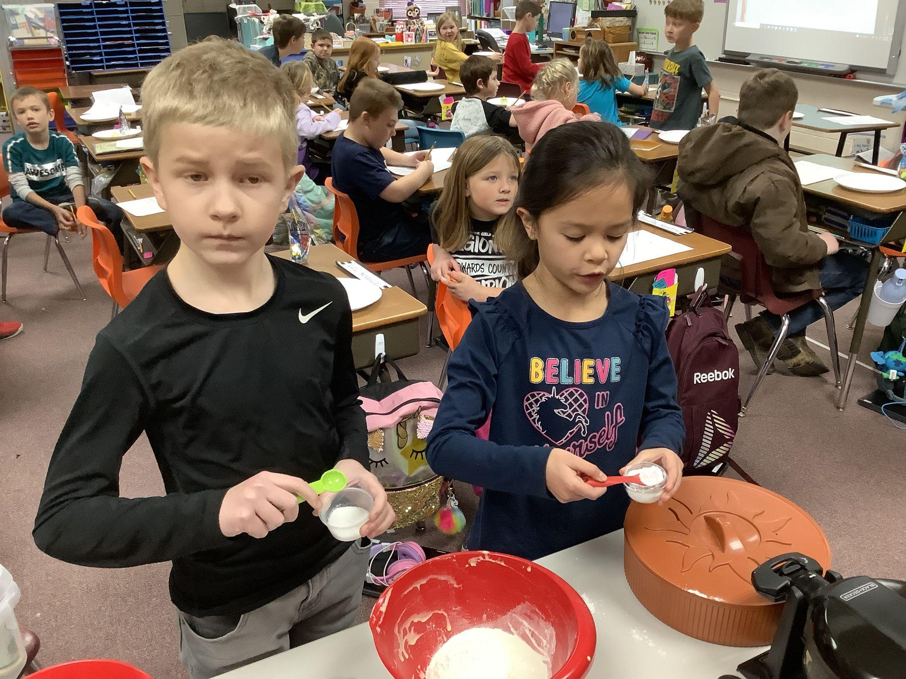
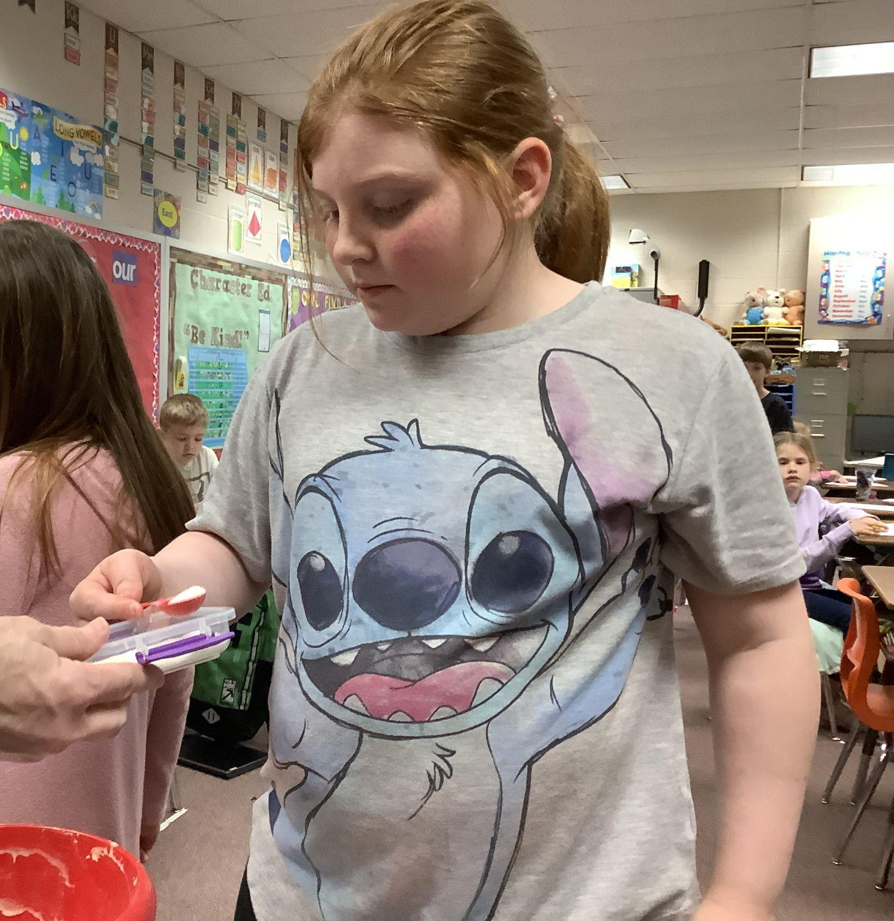
Titus and Celeste put the salt and baking powder in, then Zoey added the little bit of sugar.

Slide 4
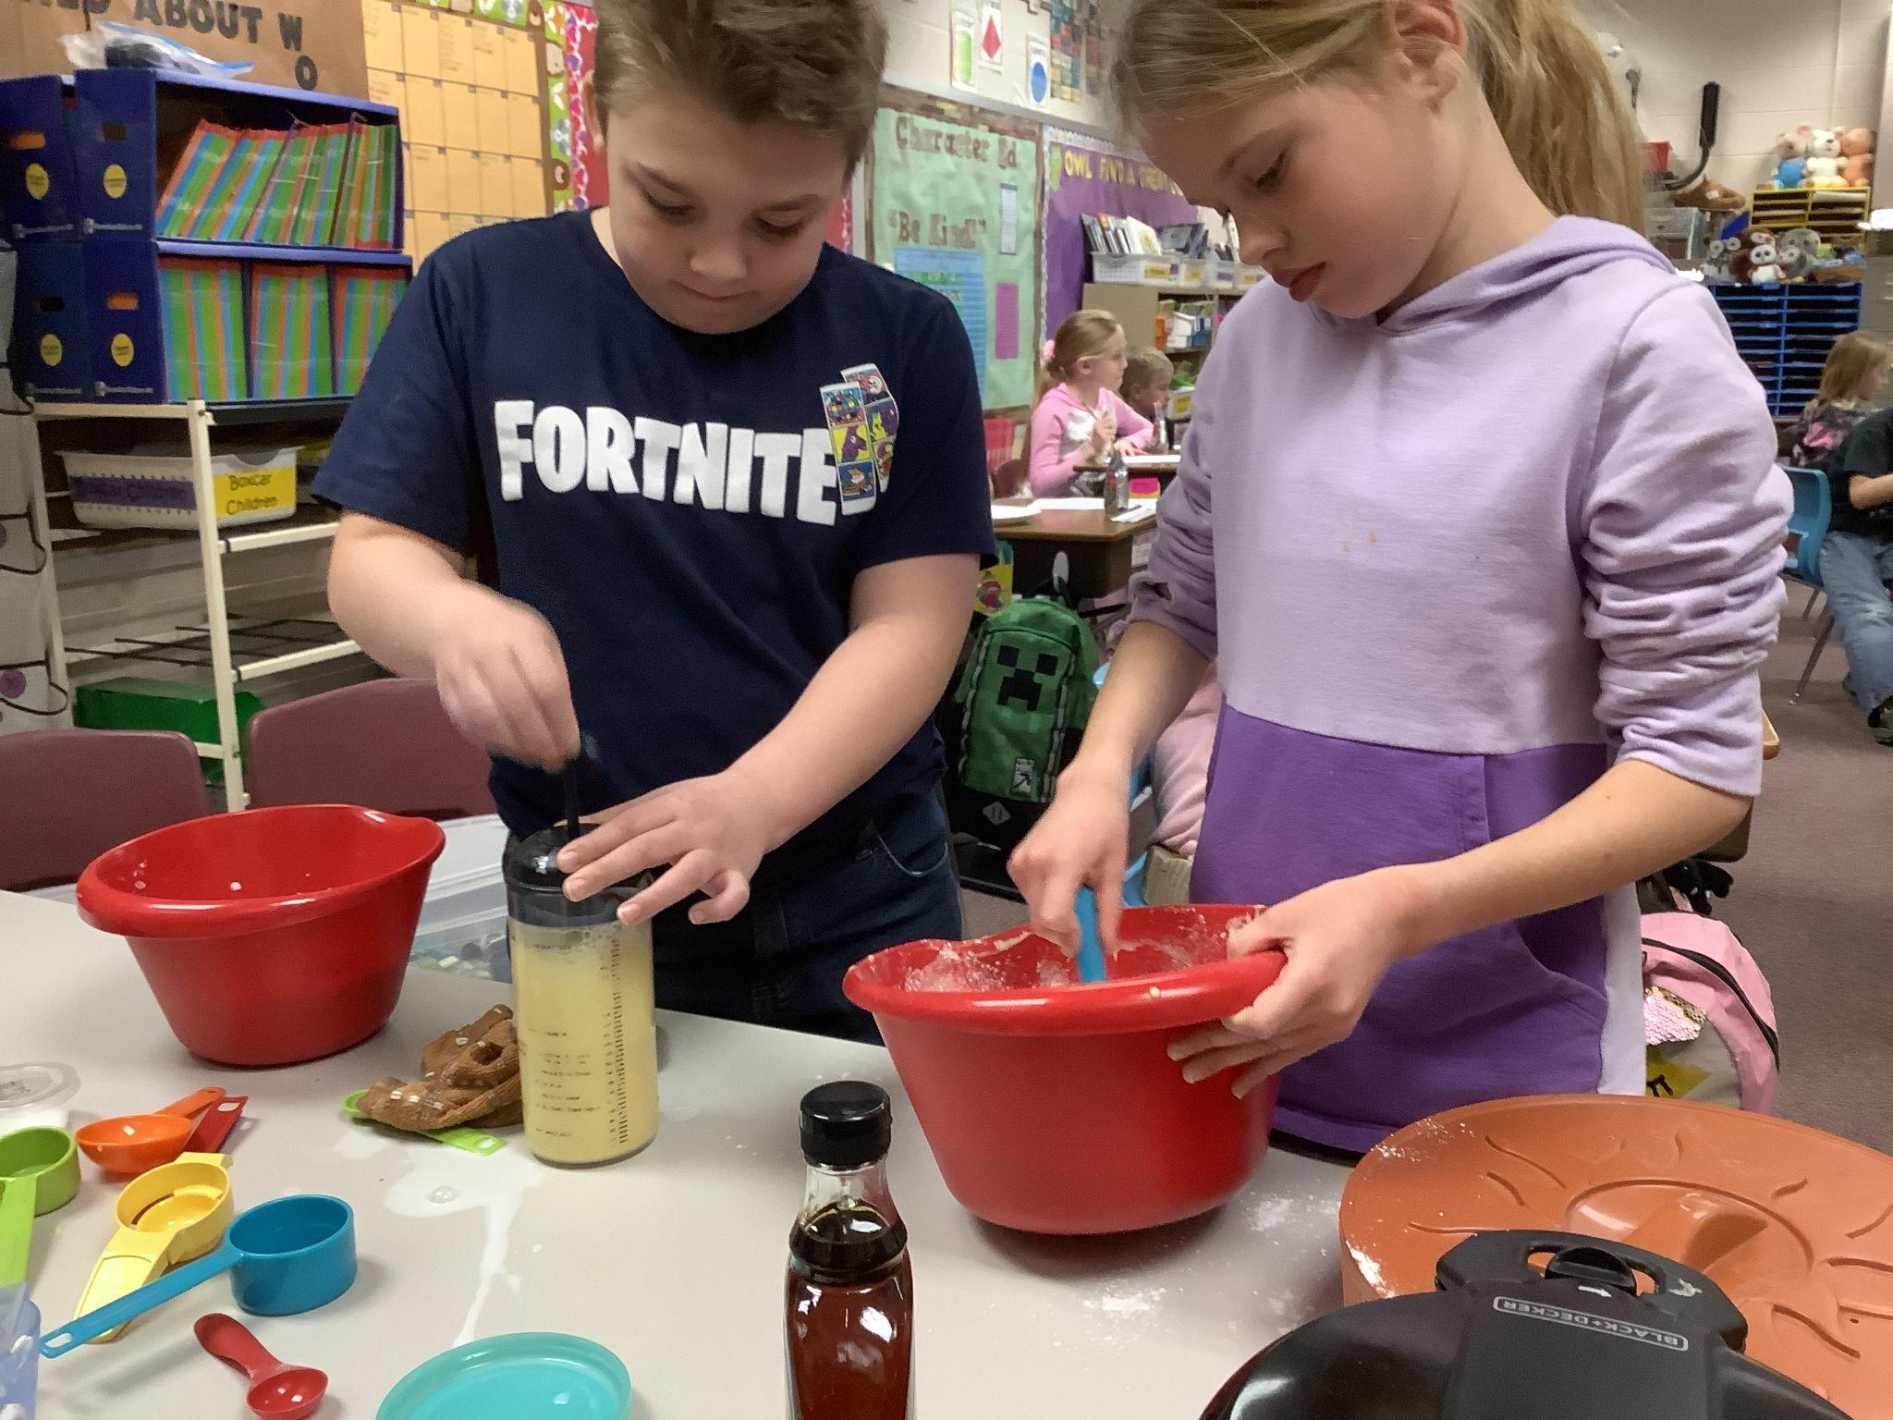
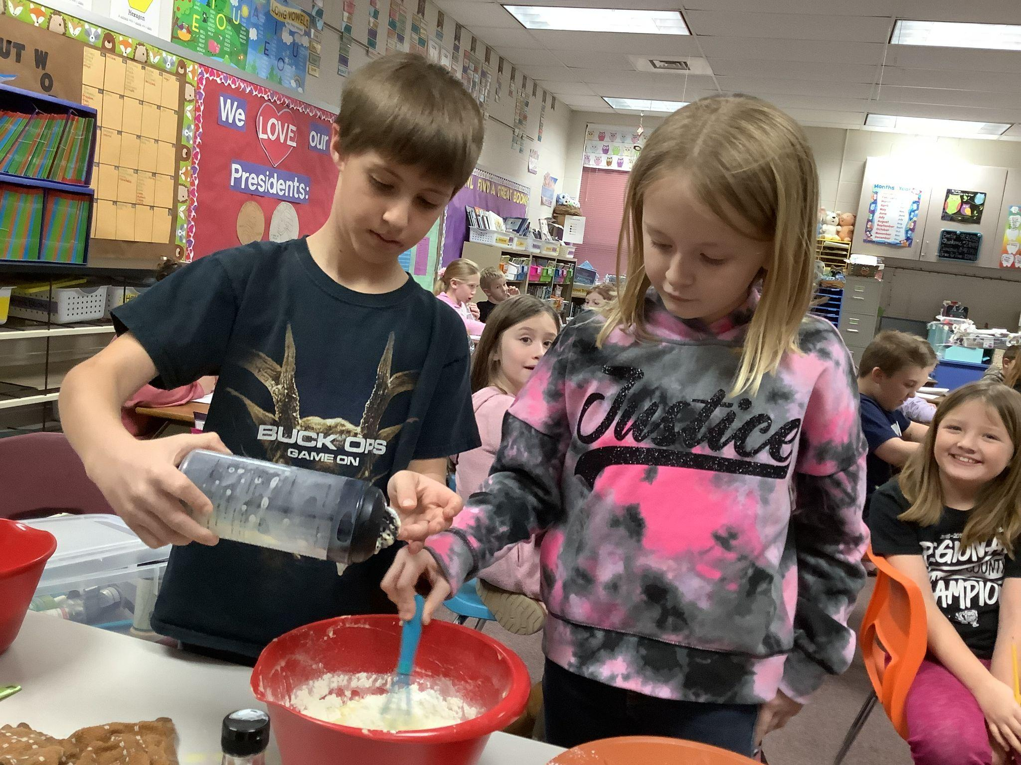
Cody mixed the milk and egg yolks while Everly mixed the dry ingredients. Wyatt and Payton mixed the liquid and dry ingredients together.

Slide 5
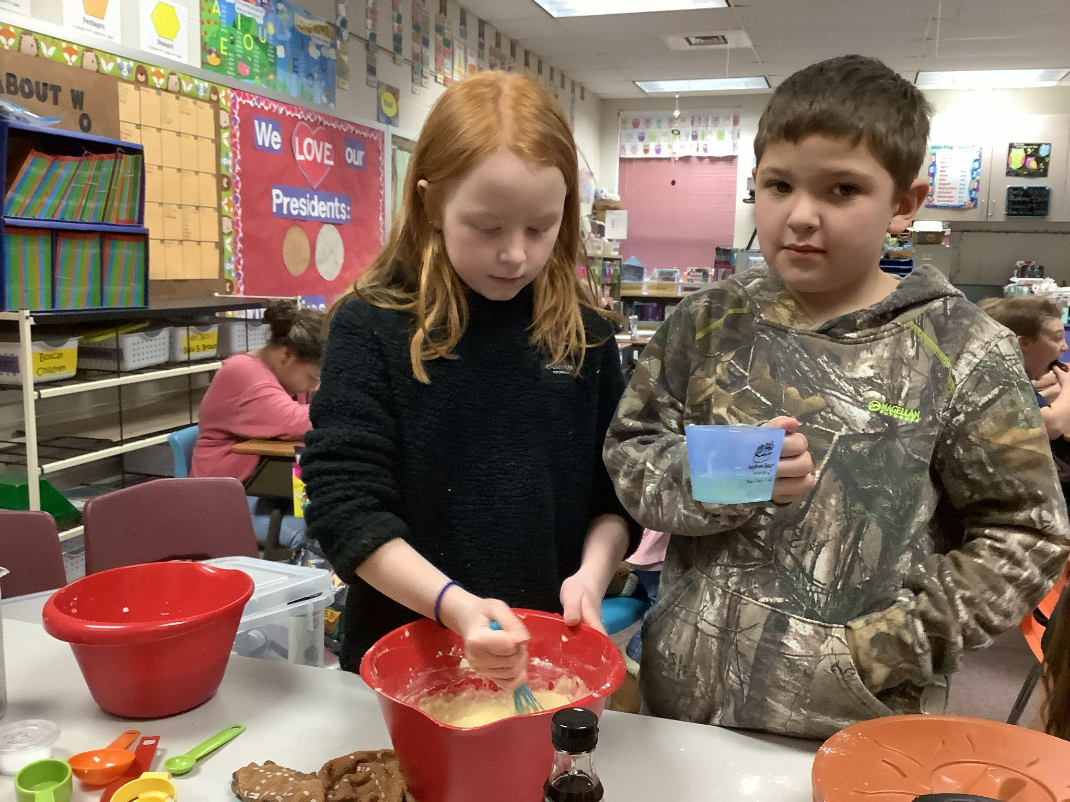
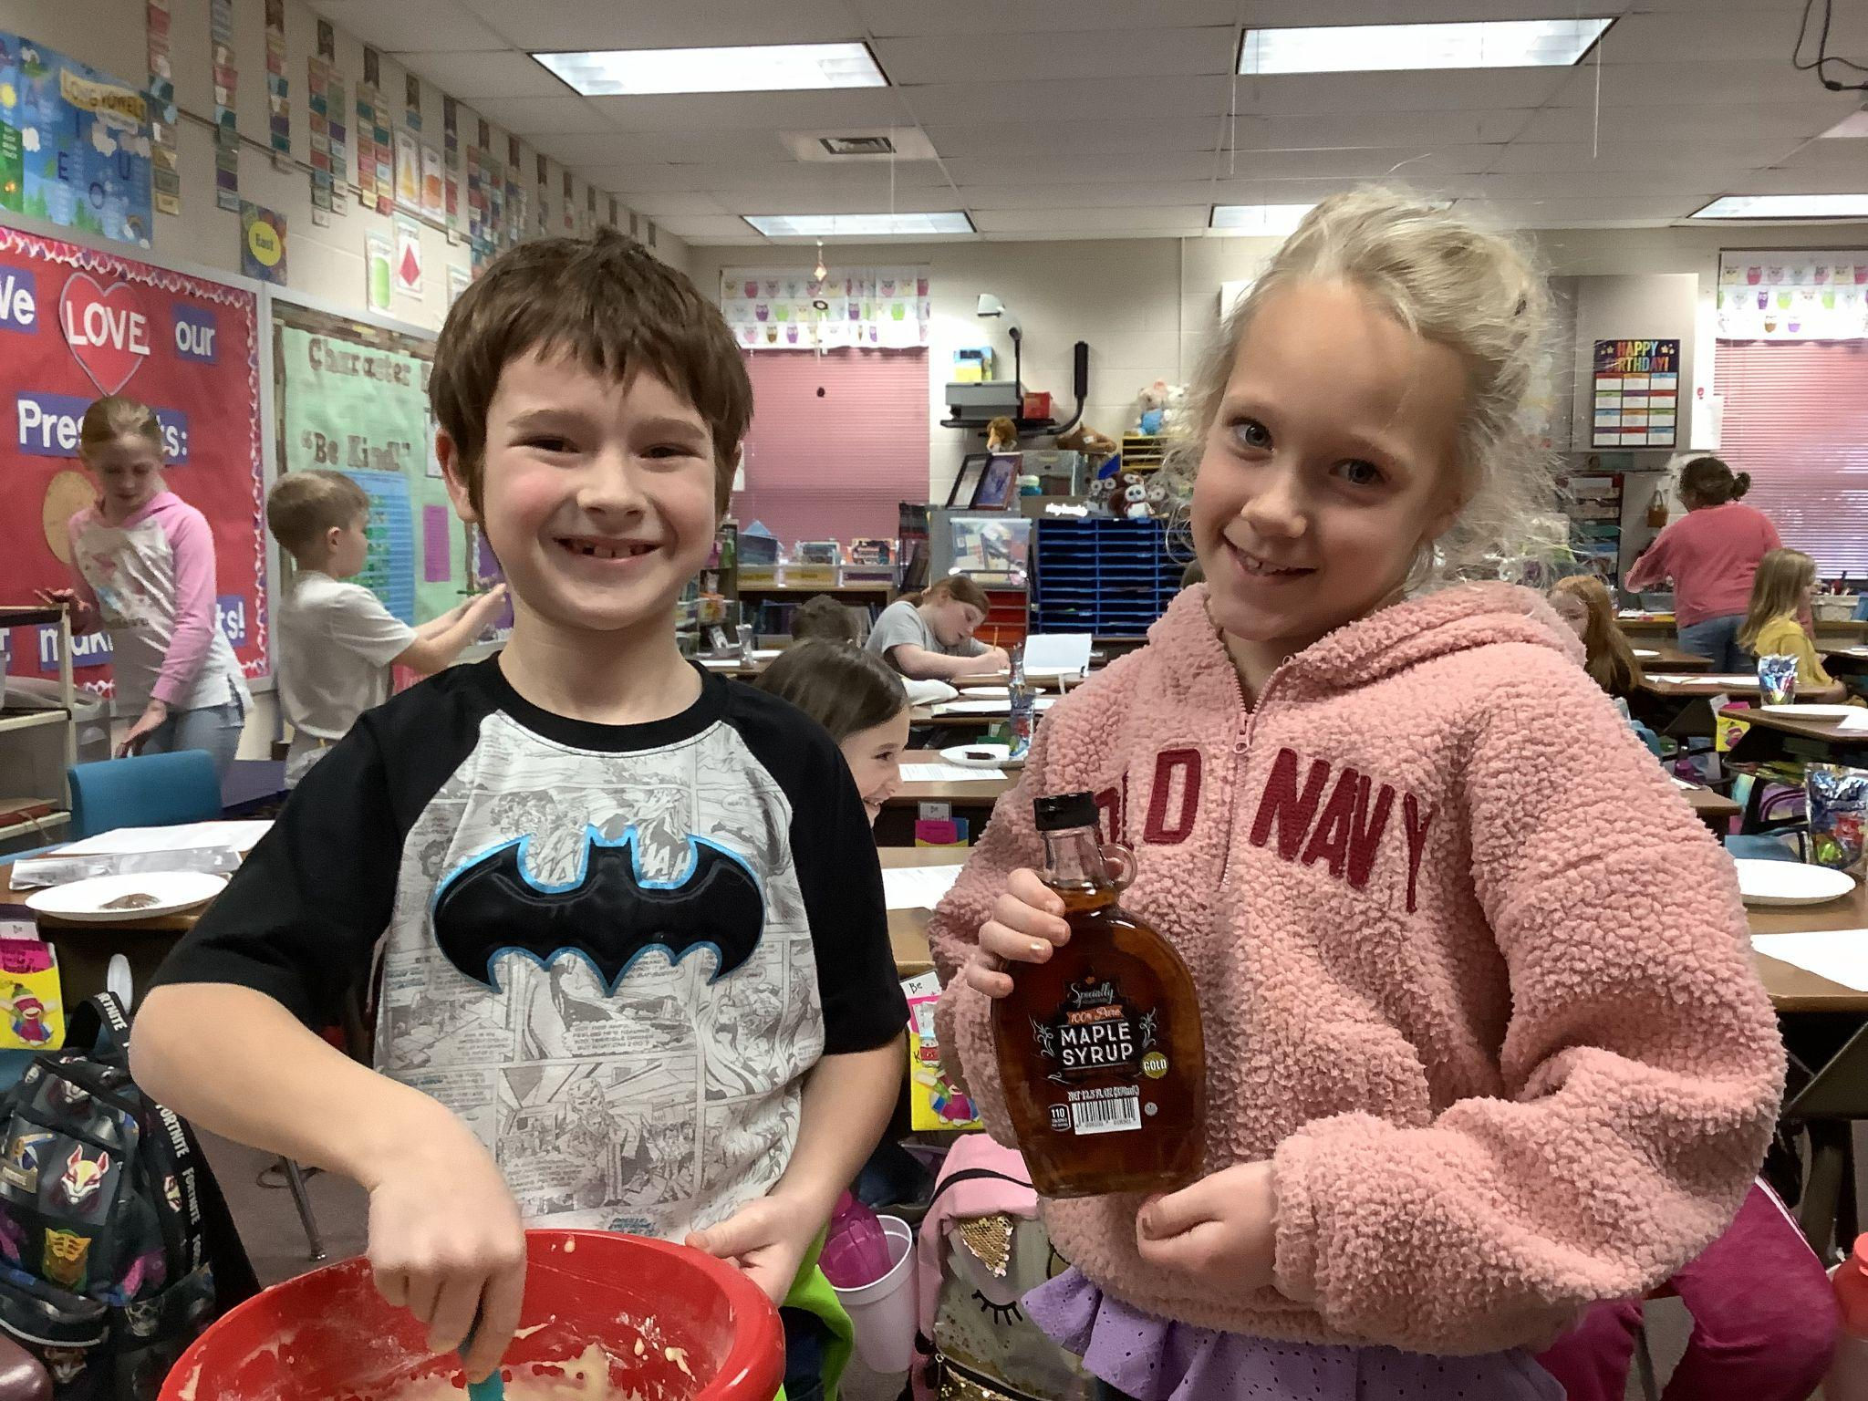
Gwen mixed the batter while Noah added the oil. Beau continued the mixing, and Kali was getting the real maple syrup ready.

Slide 6
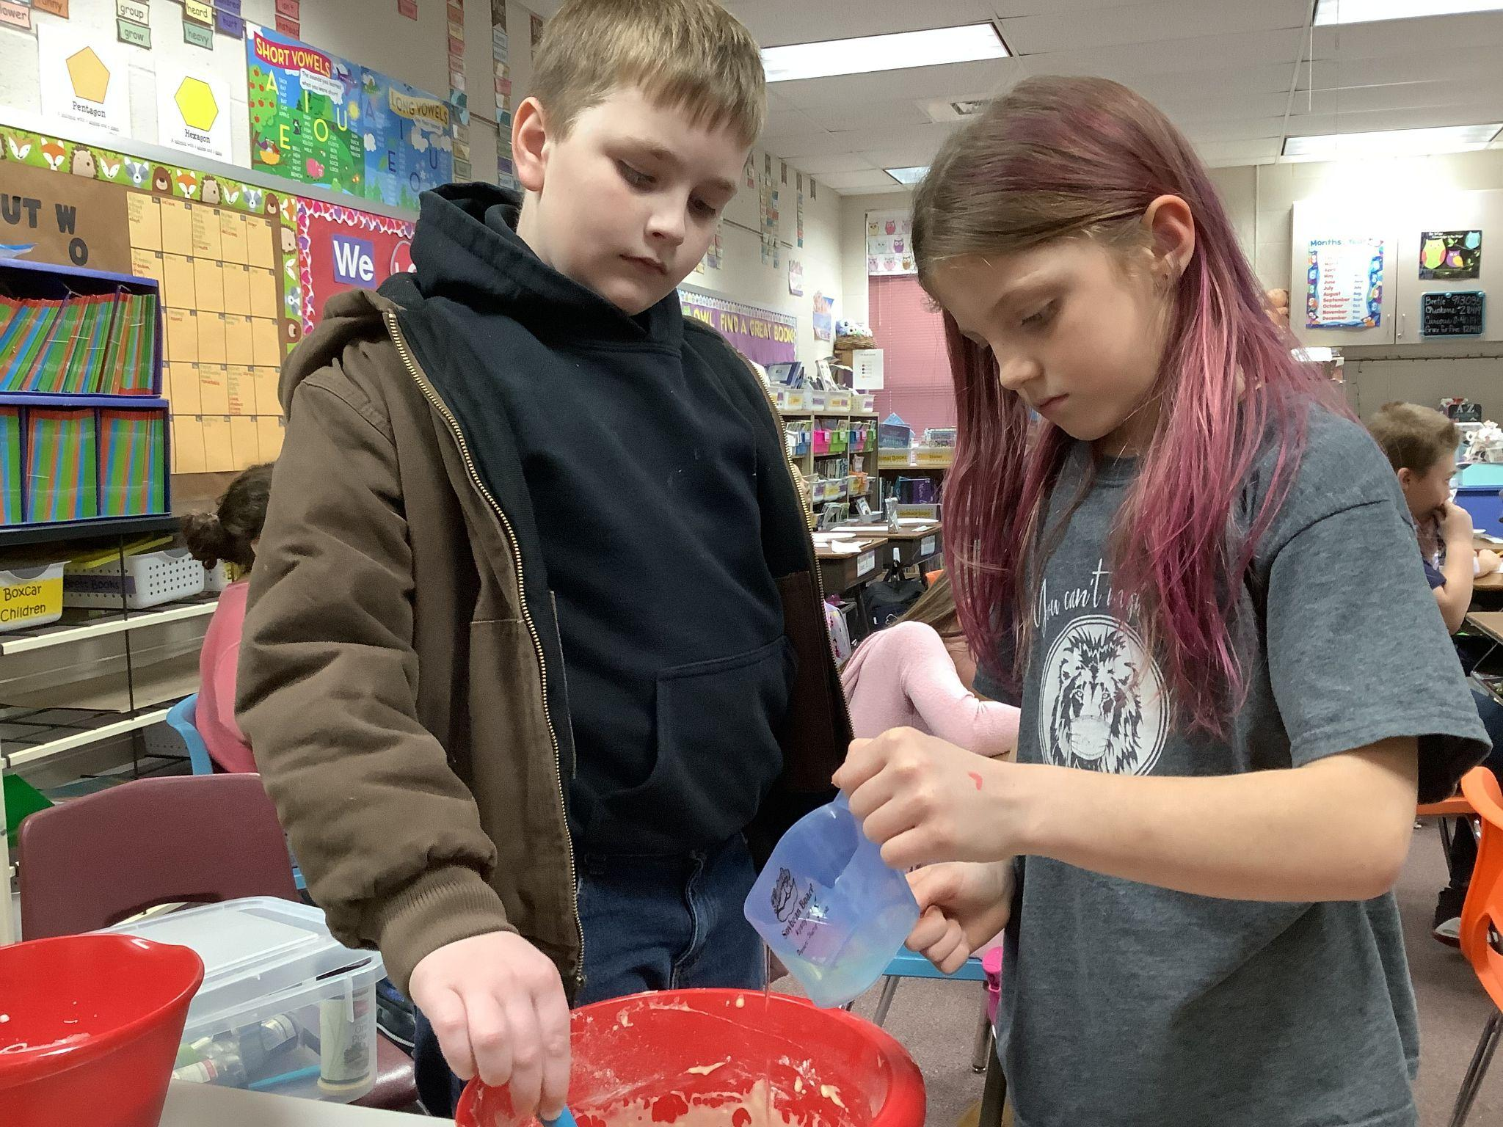
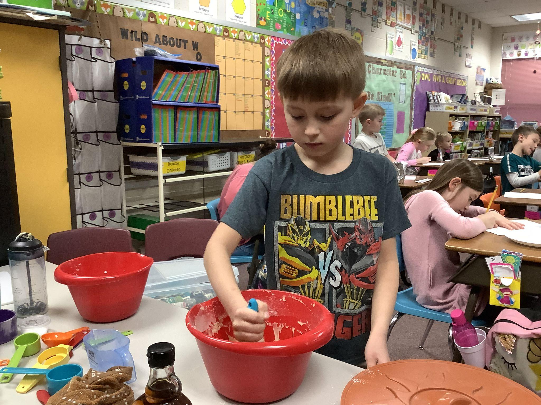
Waylon, Leah, and Bryan continued to mix the oil in. It took a little extra effort.

Slide 7
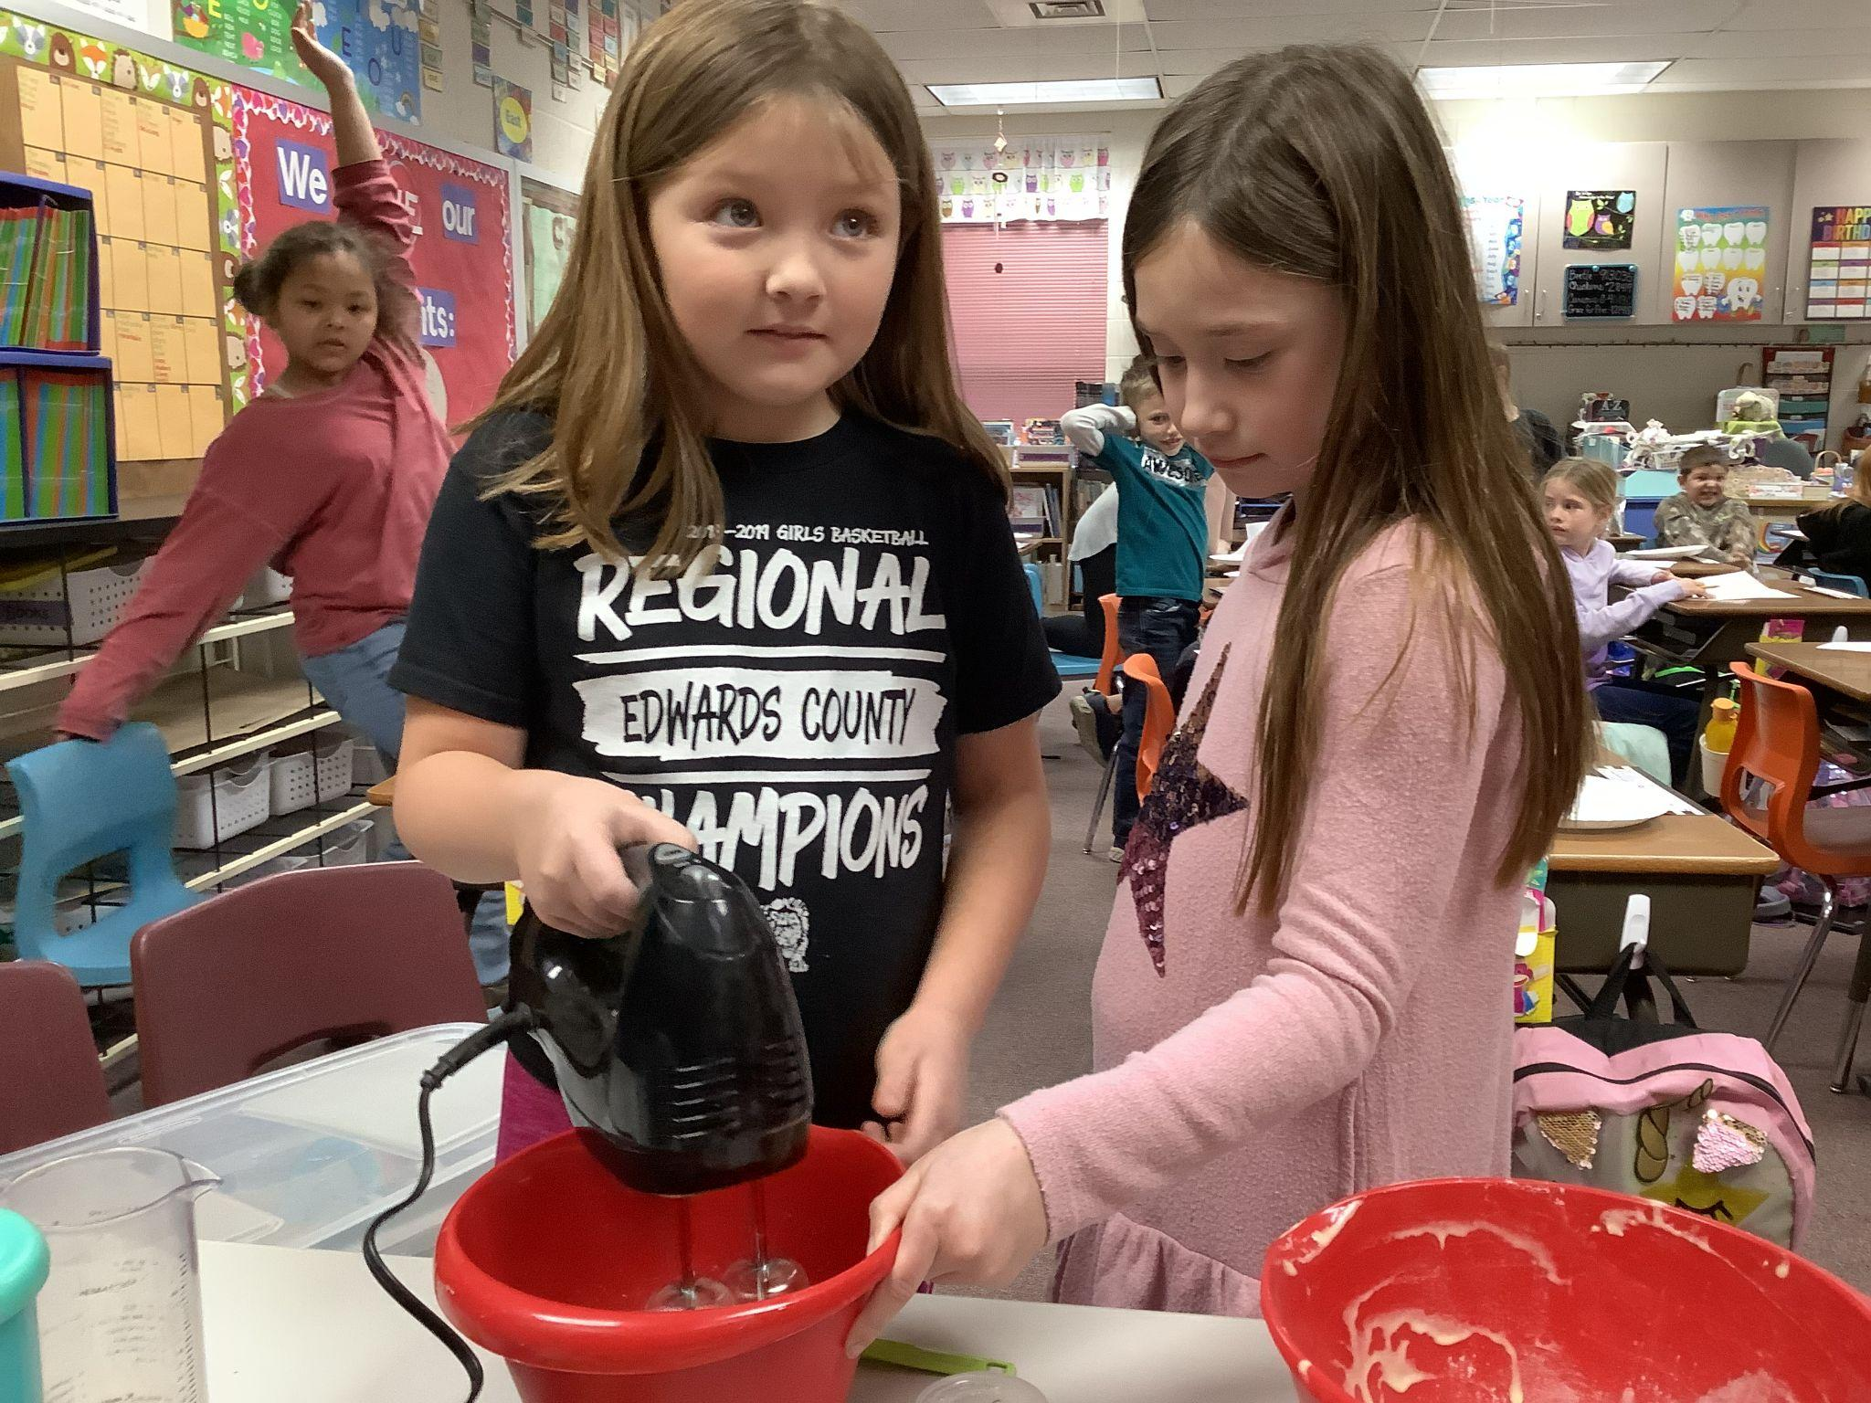
Charley and Kelly took turns mixing the egg whites until they became stiff. Our class thought the mixer was noisy, but the girls did a good job. It only took a couple of minutes.

Slide 8
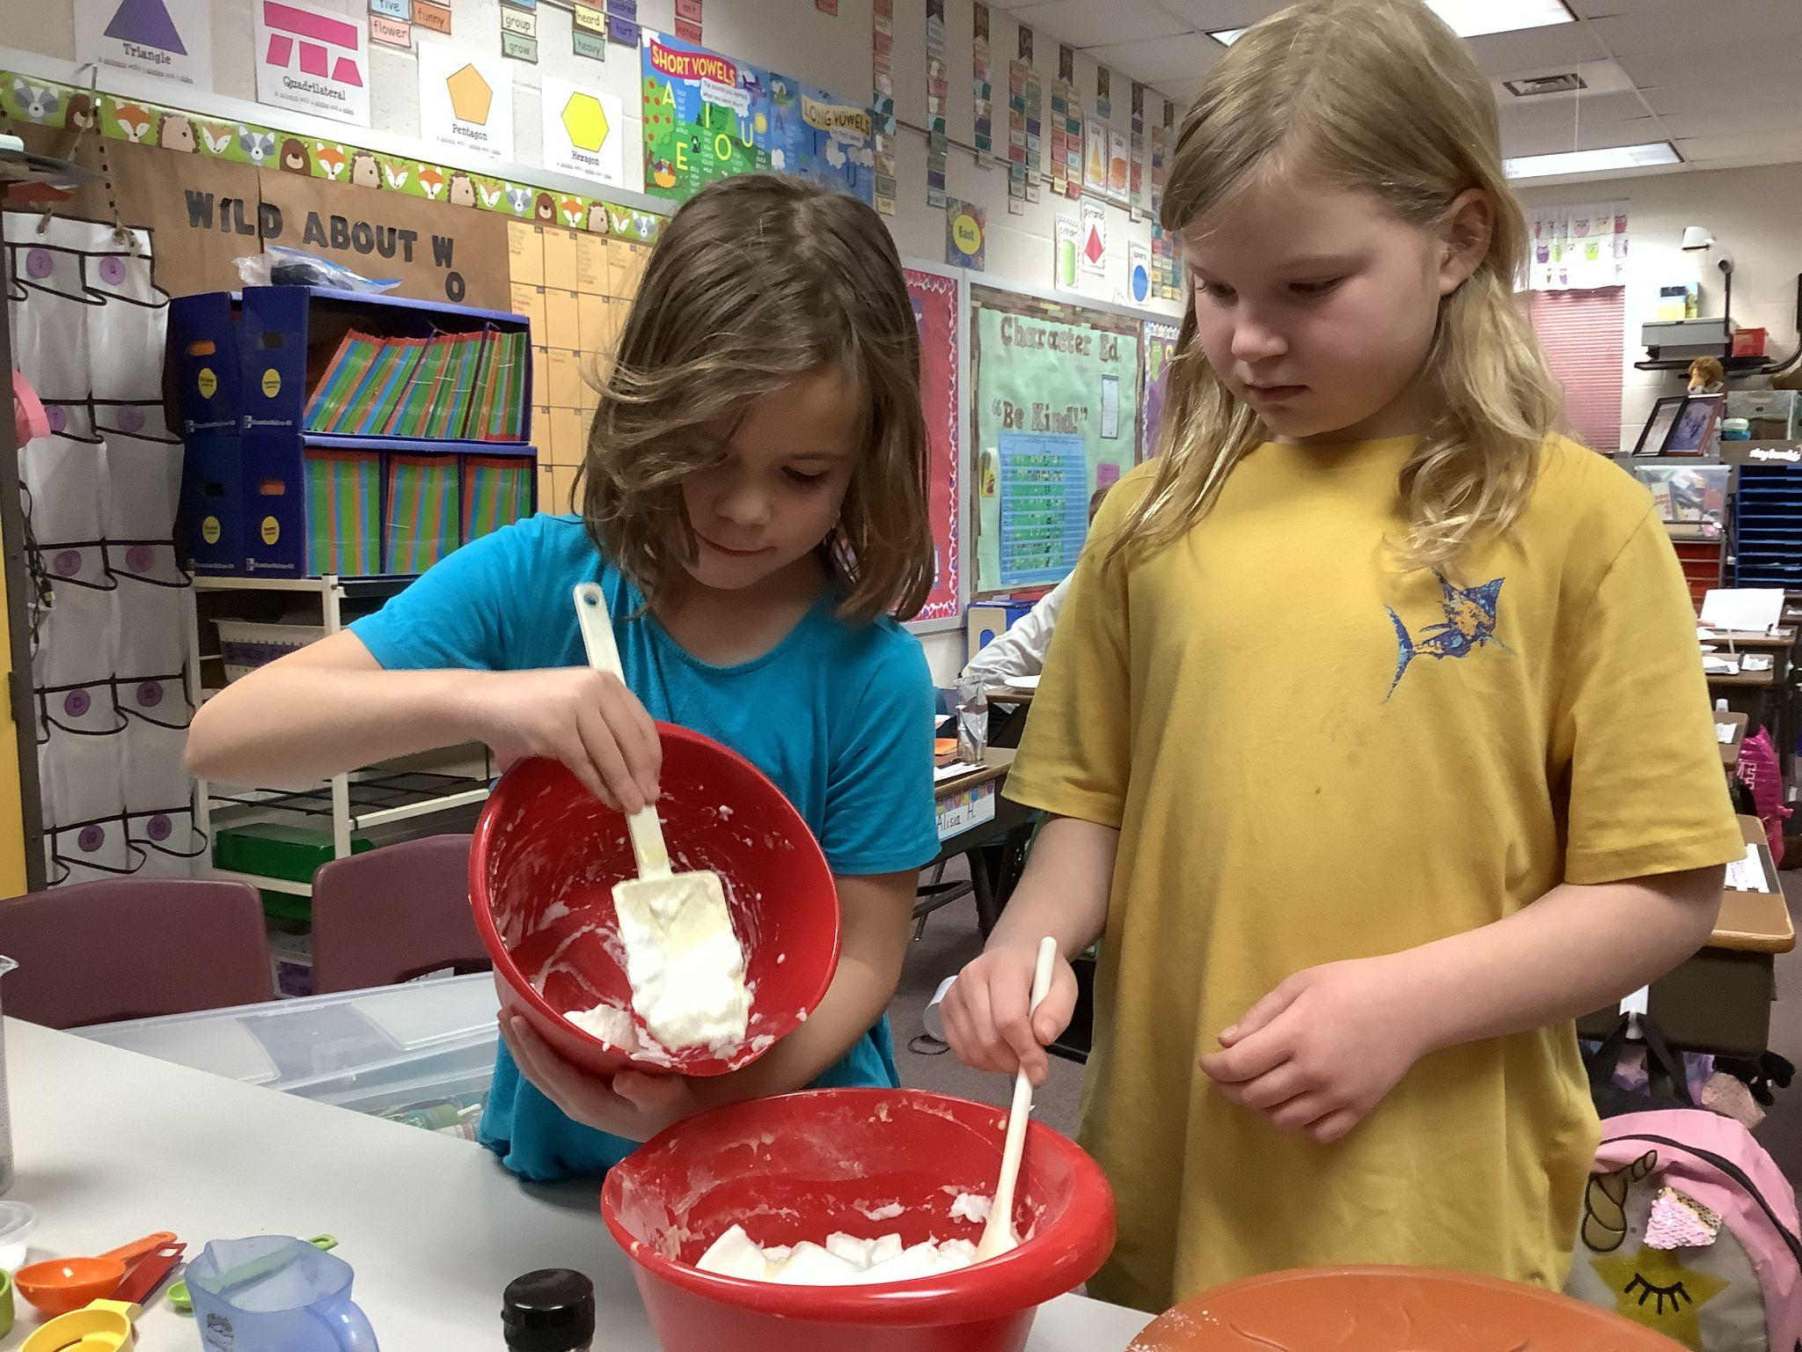
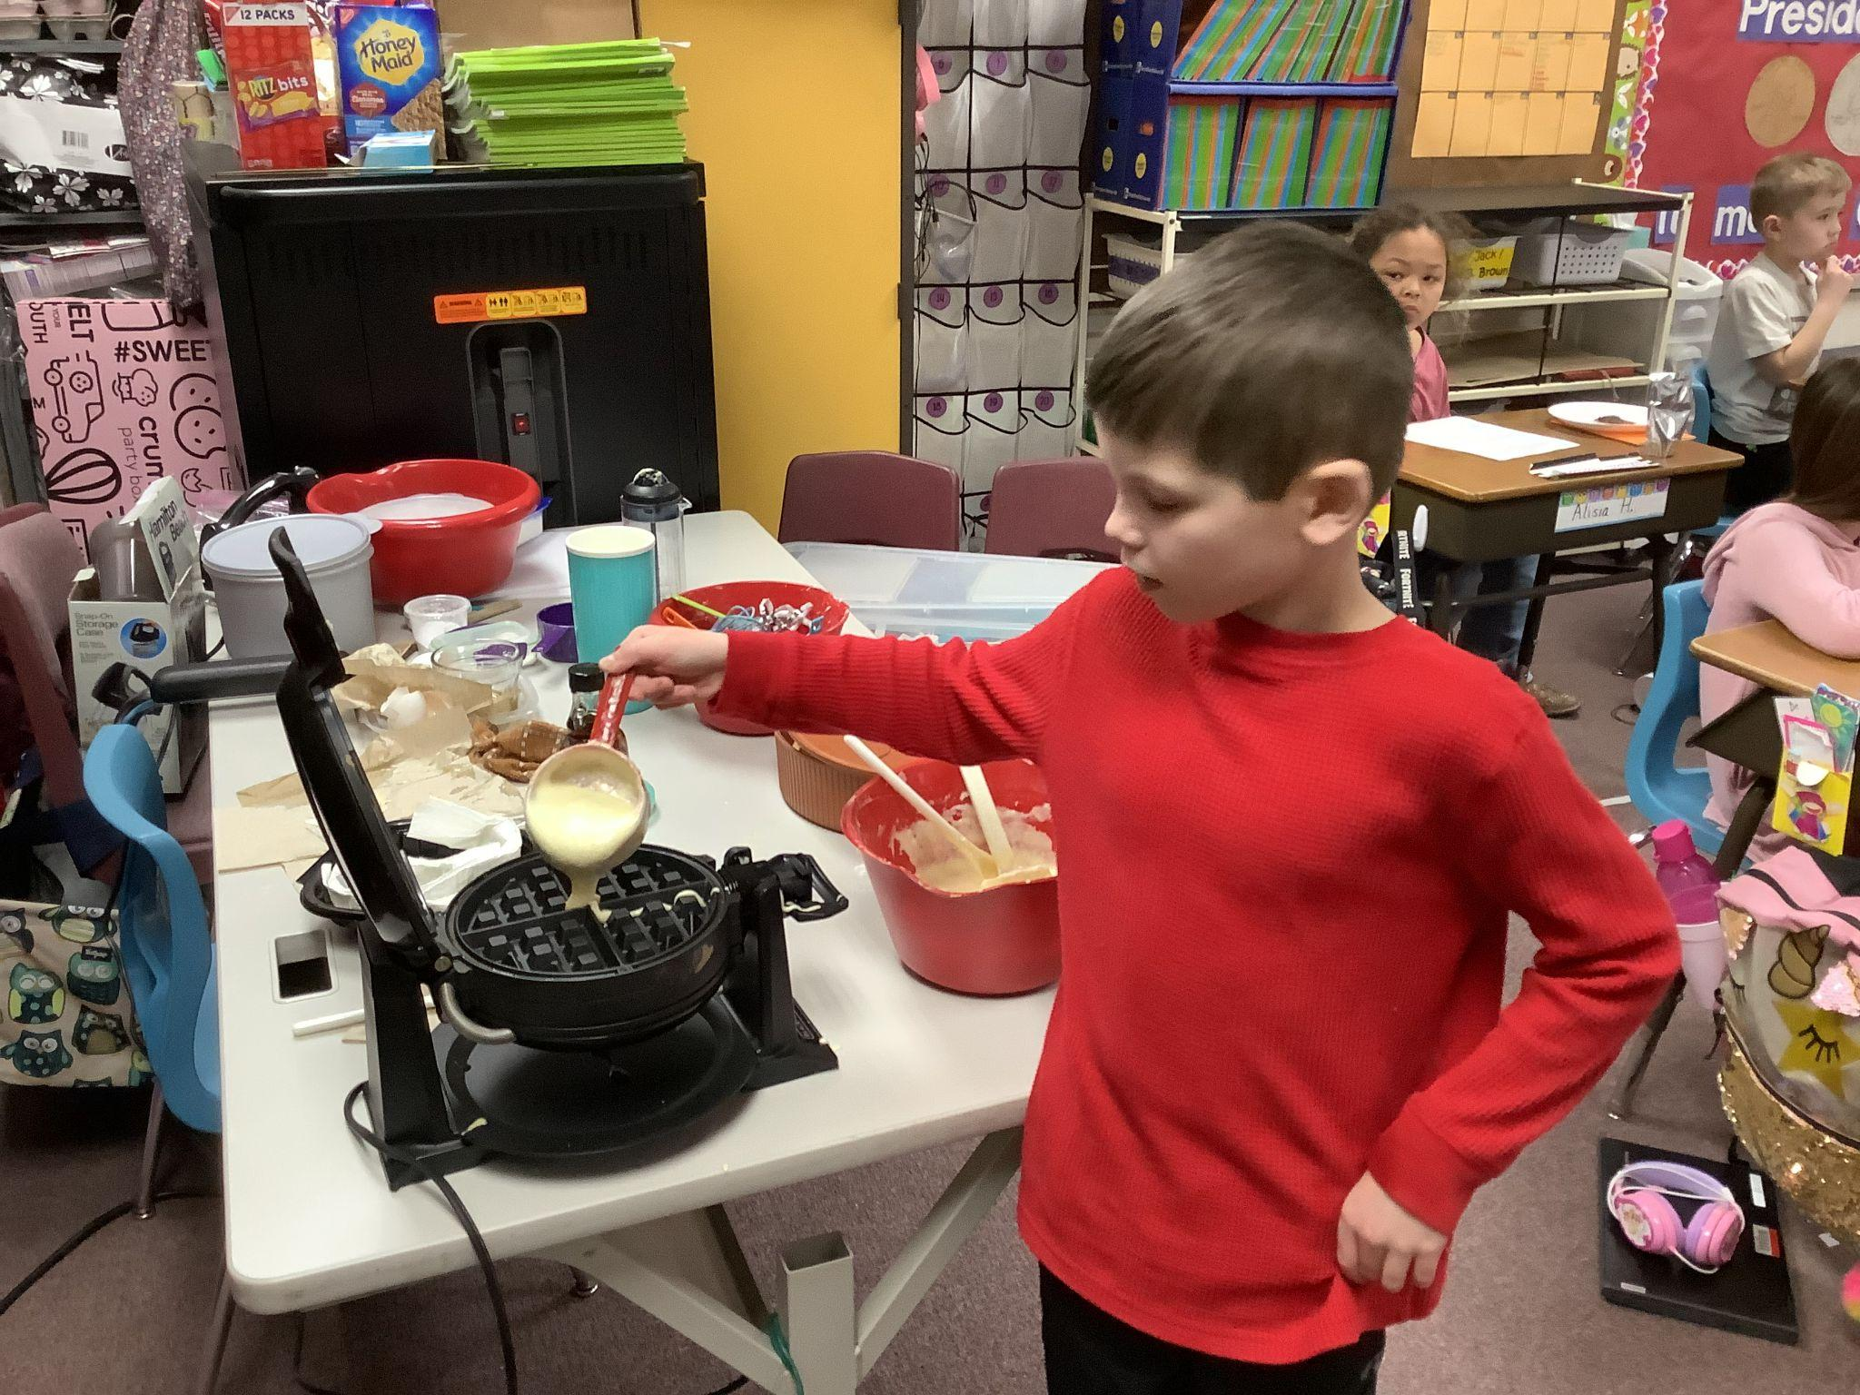
Arian and Chloe mixed the egg whites in the batter, then Eryk poured some batter on the griddle.

Slide 9
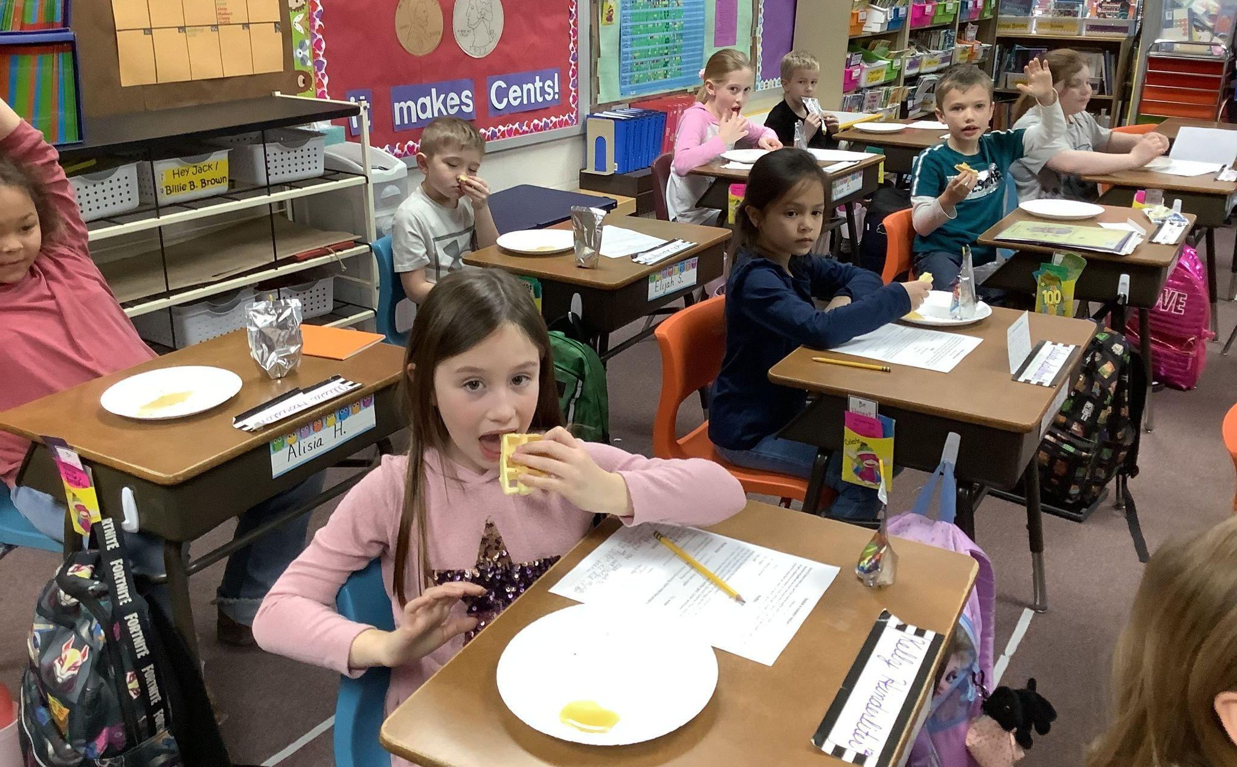
The kids enjoyed the waffles. Some weren’t crazy about the maple syrup, but at least they all tried it.

Slide 10
It’s a little challenging to get everything done with a big class, but we tried our best to keep everyone on task. While they were eating Titus’ birthday snack, we read the recipe, then we started making the waffles. When most were done with their snack, they filled in the blanks about where the ingredients came from. Once most were done, they watched a video of how maple syrup is made. Once that was finished, there were enough waffles for everyone to try. They were very good. The recipe is on my website under Winter Waffles. I hope you can enjoy making them, too! :)

Slide 11
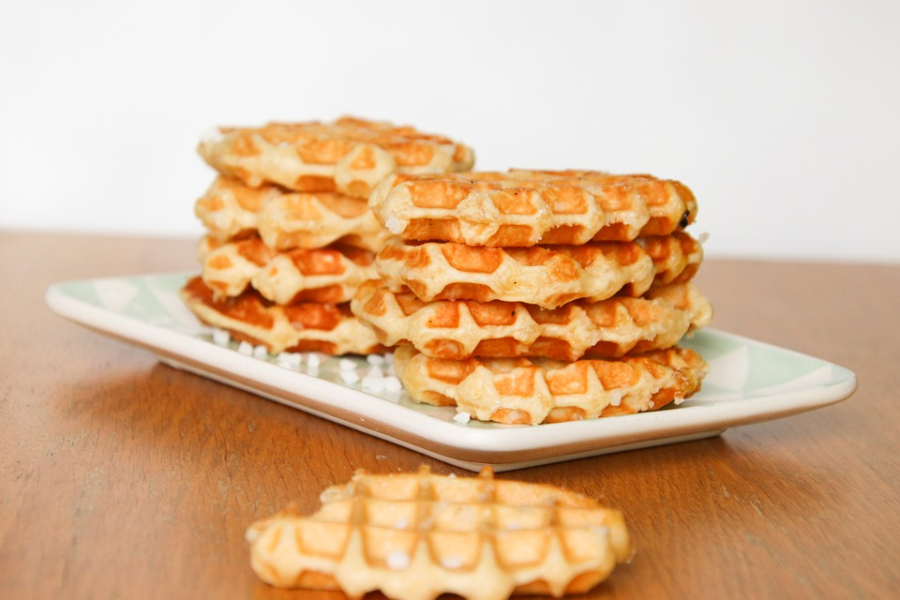
Yummy!

